Slide 1
Group 1
Ruben Holthuijsen (1064459)
Sander van Swieten (1063788)
Vince van Doorn (1061669)
Victor de Sousa Gama (0929470)
Kevin Hartman (1044032)
TYPOGRAPH TEST
Group 1
Ruben Holthuijsen (1064459)
Sander van Swieten (1063788)
Vince van Doorn (1061669)
Victor de Sousa Gama (0929470)
Kevin Hartman (1044032)
Group 1
Ruben Holthuijsen (1064459)
Sander van Swieten (1063788)
Vince van Doorn (1061669)
Victor de Sousa Gama (0929470)
Kevin Hartman (1044032)
Group 1
Ruben Holthuijsen (1064459)
Sander van Swieten (1063788)
Vince van Doorn (1061669)
Victor de Sousa Gama (0929470)
Kevin Hartman (1044032)
Group 1
Ruben Holthuijsen (1064459)
Sander van Swieten (1063788)
Vince van Doorn (1061669)
Victor de Sousa Gama (0929470)
Kevin Hartman (1044032)

Slide 2
COLOR PALETTE
#80B4B5
#61A6A2
#E1B7B1
#C87777
#7267A2
#575295
#9AB6DA
#6985BF
#A7C374
#8EAE54

Slide 3
Intentionally left blank

Slide 4
RNA sequencing-based Machine Learning for Detection of
Triple Negative Breast Cancer
Ruben Holthuijsen (1064459) • Sander van Swieten (1063788) • Vince van Doorn (1061669)
Victor de Sousa Gama (0929470) • Kevin Hartman (1044032)

Slide 5
Outline
TODO - Opleuken met icoontjes
Context
Approach
Results
Discussion

Slide 6

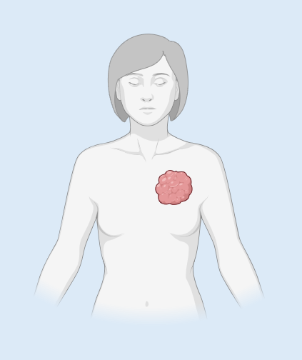



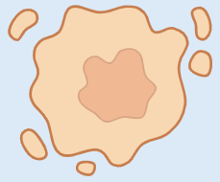

Context
2.300.000 cases of breast cancer worldwide in 2022
TNBC - Overview
Women younger than 40 years of age are highest risk
Triple-Negative Breast Cancer
~10-20% of breast cancer
Triple-Negative Breast Cancer (TNBC)
Breast Cancer
(BC)
ER (ESR1)
/
PGR (PGR)
/
HER2 (ERBB2)
/

Slide 7
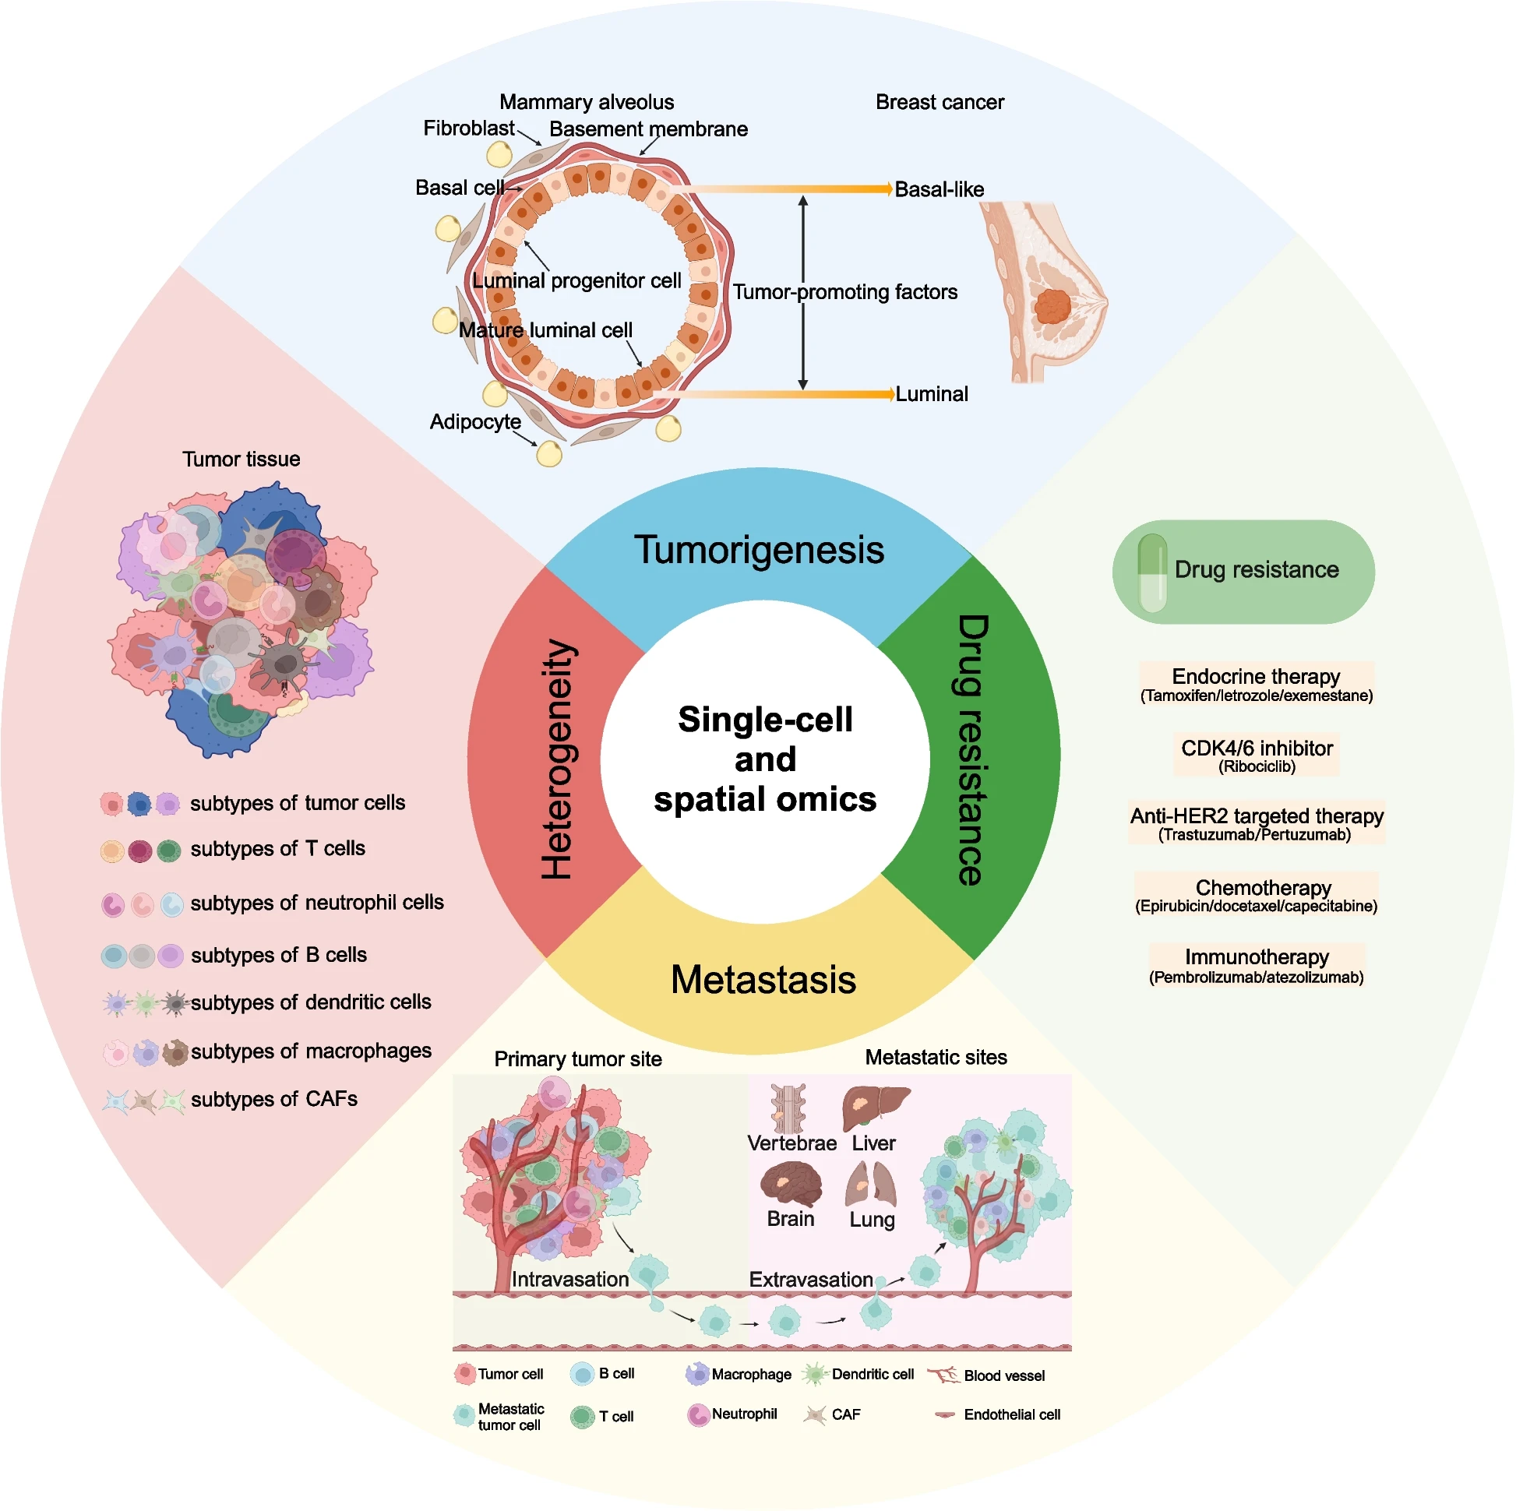
Context
TNBC - Overview
Source:
Xiong et al. Biomarker Research (2024) 12:107
doi 10.1186/s40364-024-00654-1

Slide 8
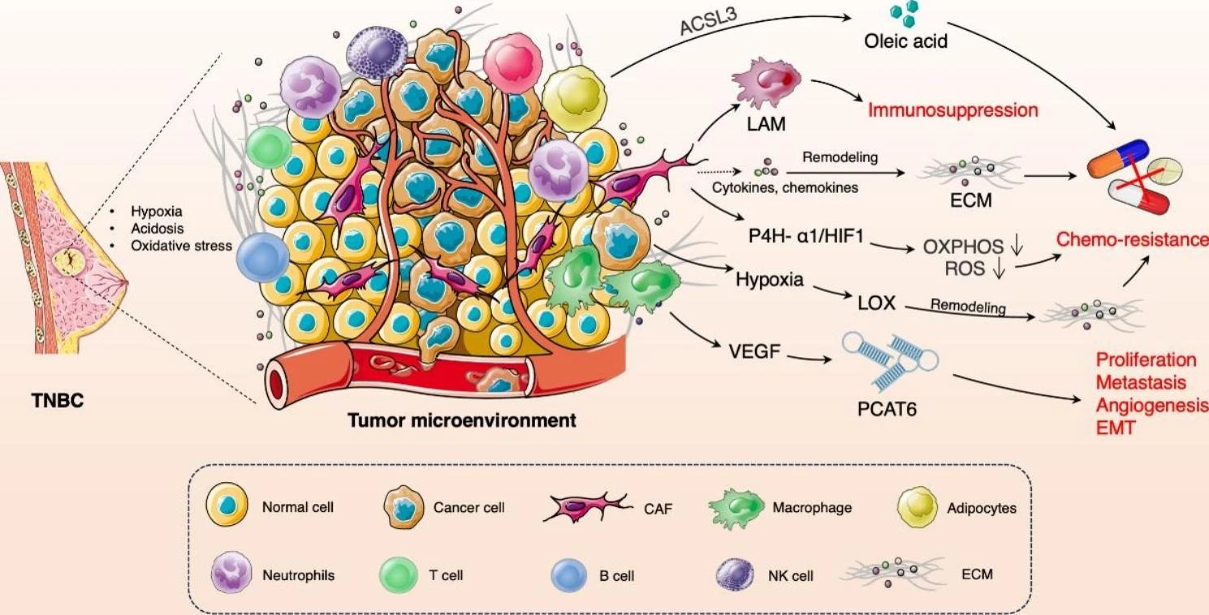
Context
TNBC – Tumor Microenvironment (TME)
Source:
Liu et al. Molecular Cancer (2023) 22:145
doi 10.1186/s12943-023-01850-7

Slide 9
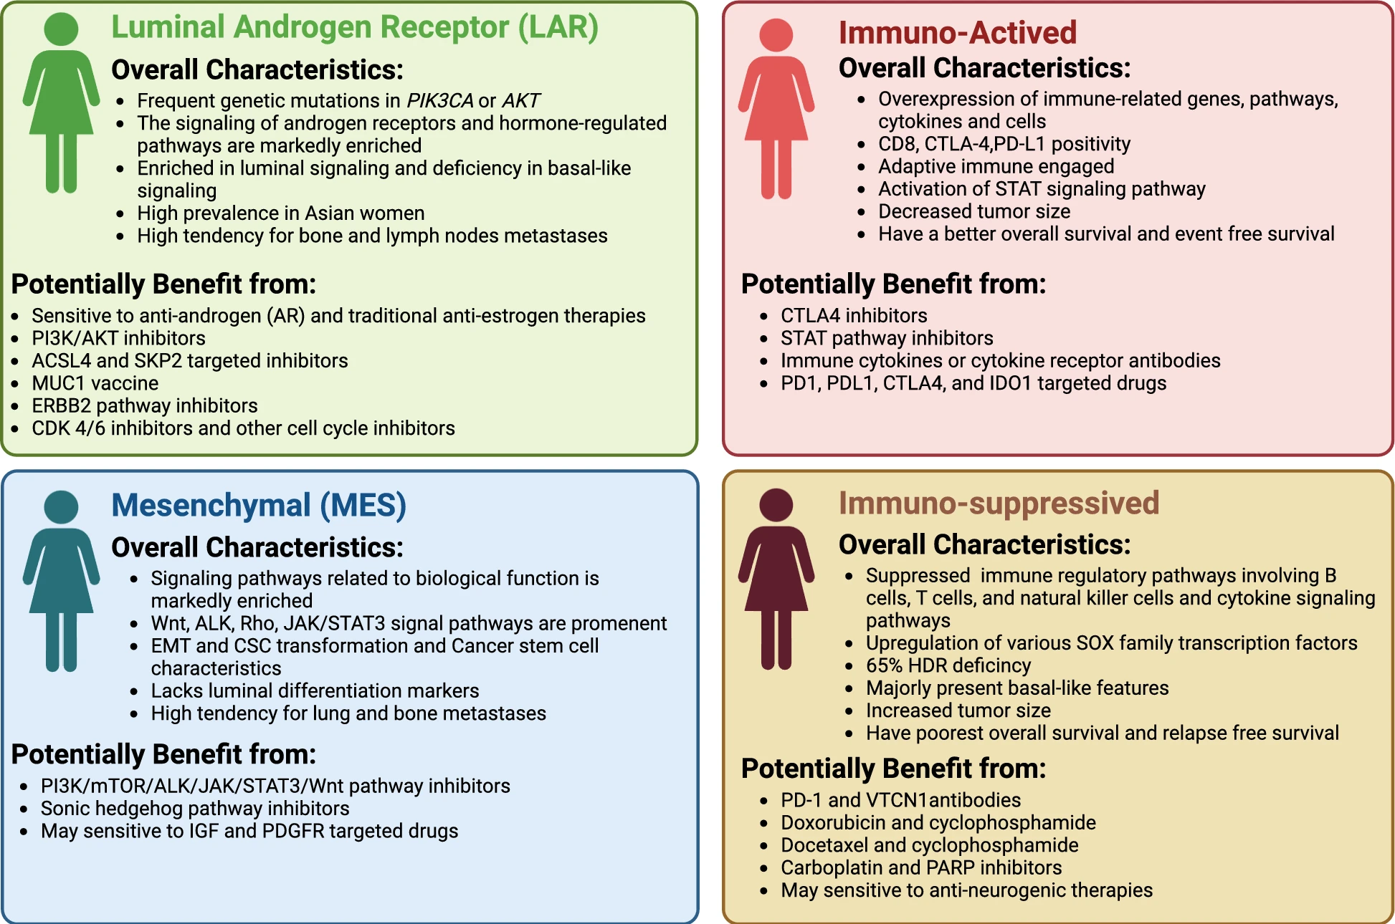
Context
TNBC – Subtyping
Source:
Chen et al. Cell & Bioscience (2025) 15:13
doi 10.1186/s13578-025-01359-0

Slide 10
Approach
Project
TCGA-BRCA
GSE65216
GSE76250
Outlier removal
Imputation
Mean removal
Standardization
Deduplication
Literature
Two methods:
Result 1 article
Review 65 articles
Machine learning
(with SMOTE)
Five methods:
PCA
BORUTA
LASSO
RFE
Statistical
Logistical regression Support Vector Machine
Random Forest
Classification
TNBC / nTNBC
Data loading
Preprocessing
Feature
selection
Model
Output

Slide 11
Approach
RNA expression data of TNBC patients
Data loading
Train/Test
Validation
TCGA-BRCA n = 1097
GEO n = 264
GSE65216, GSE76250
Label based on clinical data
Label based on metadata case
Drop indeterminable cases
Drop cases without RNA data
Tumor samples:
Breast cancer (BC)
Triple-Negative Breast Cancer (TNBC)

Slide 12
Approach
Preprocessing
Missing data
Dimensionality
Harmonization
Imputation
One fifth of the minimum value recorded
KNN
Selection
Quantified in all datasets
Deletion
With near-zero variance
Recursive feature elimination
Principal Component Analysis
Outlier removal
Applying logarithm transformation
Scaling
Standardization
Deduplication
Rows (cases)
Columns (genes)

Slide 13
Approach
Feature selection
Literature
Machine learning
Result 1 article
Feature extraction: PCA
60660 features (all)
65 research papers
oncogenes and biomarkers
Feature selection: BORUTA (Random Forest)
284 features
(research papers)
Feature selection: LASSO (Regression)
SMOTE
Feature selection: RFE (Support Vector Machine)
Statistical methods
19962 features (protein)

Slide 14
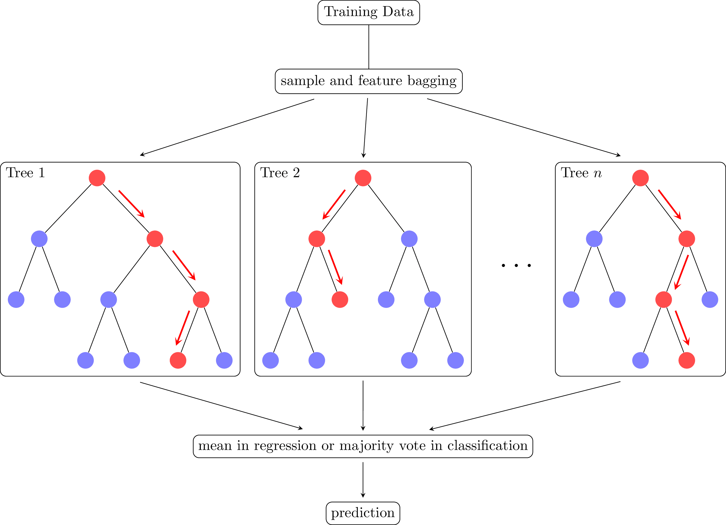
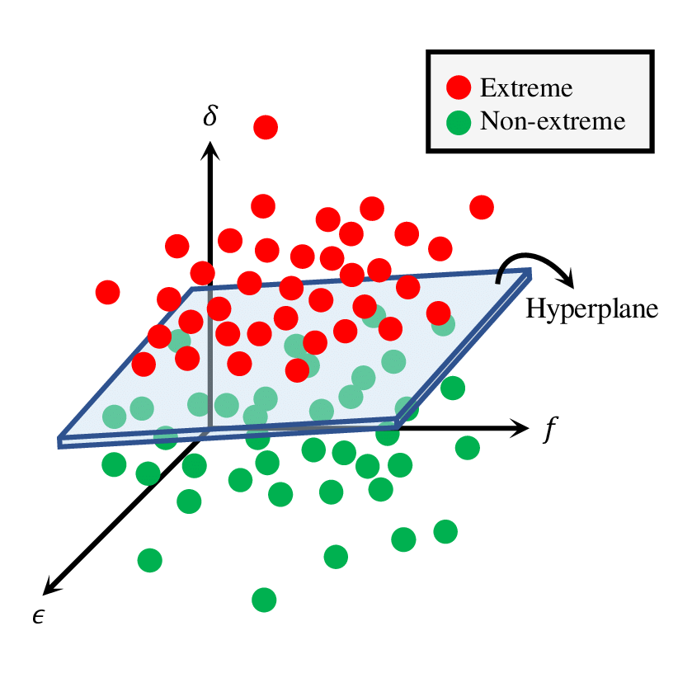
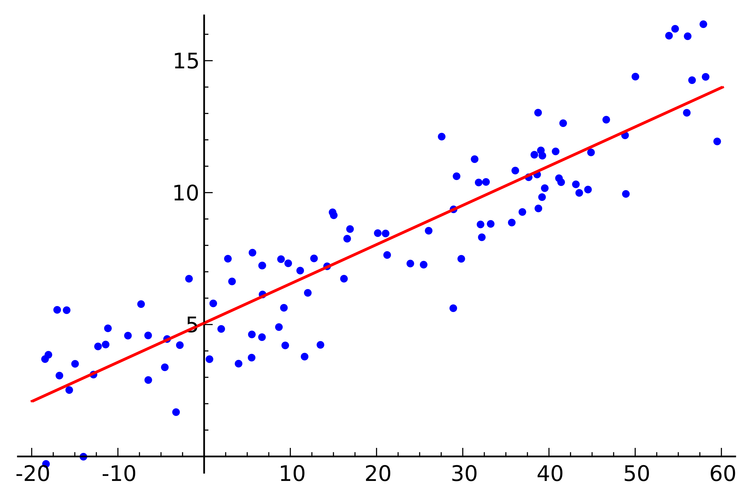
Approach
Models
Logistic regression
Random Forest
Support Vector Machine
SMOTE
Something
Else
here

Slide 15
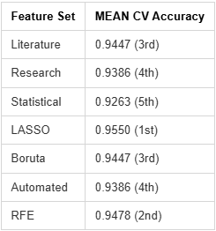
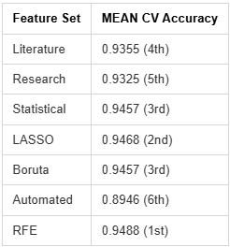
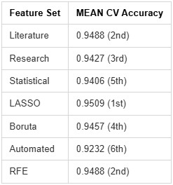
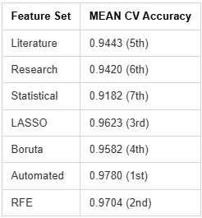
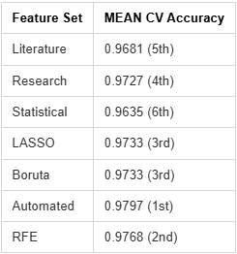
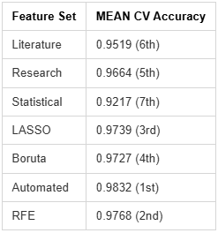
Logistic regression
Random Forest
Support Vector Machine
Approach
Models
SMOTE
Logistic Regression
Random Forest
Support Vector Machine
Notes:
TODO: Part of approach or results?

Slide 16
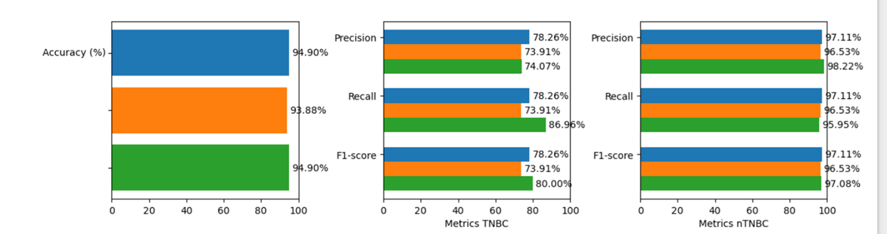
Train / Test
Research Papers
Results
Statistical
Validation
Research Papers
Statistical

Slide 17
Discussion
Findings / conclusion

Slide 18
Thank you for your attention
Ruben Holthuijsen (1064459) • Sander van Swieten (1063788) • Vince van Doorn (1061669)
Victor de Sousa Gama (0929470) • Kevin Hartman (1044032)

